Slide 1
Rating & Recommended

Slide 2
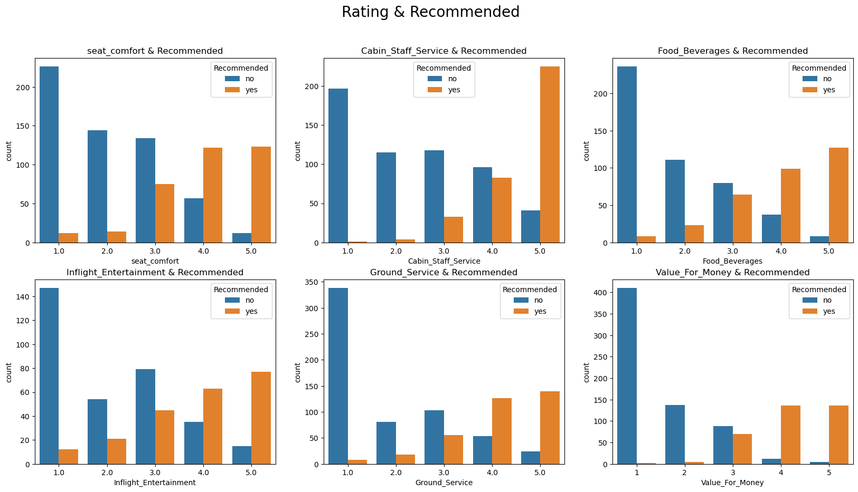
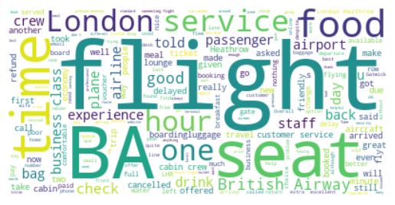
“time”,”flight”,”seat” ,”food”,”service. These are the most frequently mentioned words. This means that customers care about these things
The rating score has a great influence on customer recommendations

